Slide 1
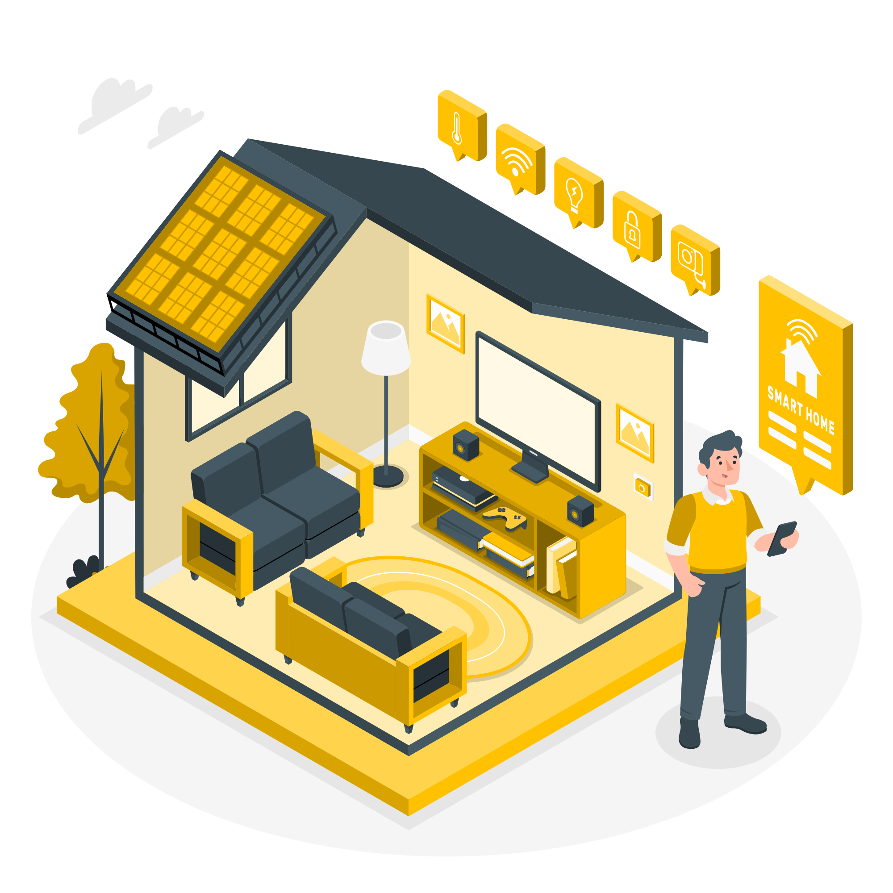

Smartie
Connect
By Kaveh Nejad, Allegra Santoro, Borislav Alexandrov
and Bradley Todd

Slide 2
Table of Contents
01
02
03
04
05
06
ABOUT US
EXPLANATION OF INDIVIDUAL NODES
THE MQTT SYSTEM
What is Smartie Connect
An overview of all the nodes in the environment
How we implemented MQTT
DISCORD SERVER
UNIT TESTS
CONCLUSION
An overview of our server
An overview of the unit tests implemented
A quick recap

Slide 3
About
Us
01
What is Smartie Connect?

Slide 4
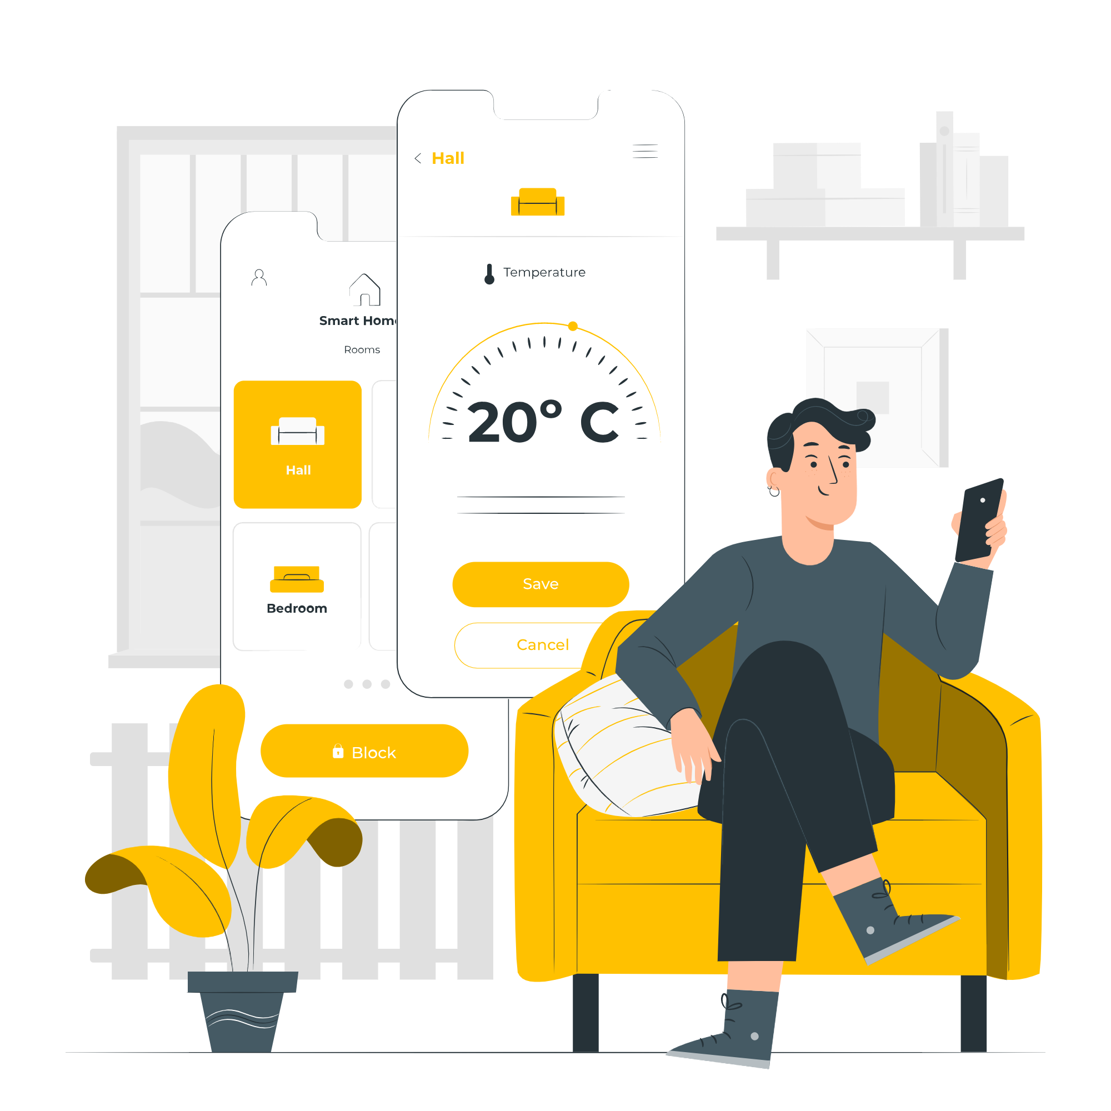
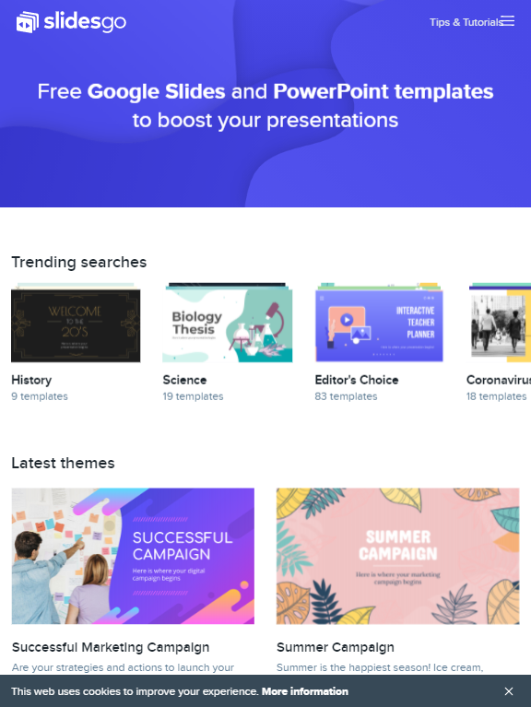
Smartie connect

Slide 5
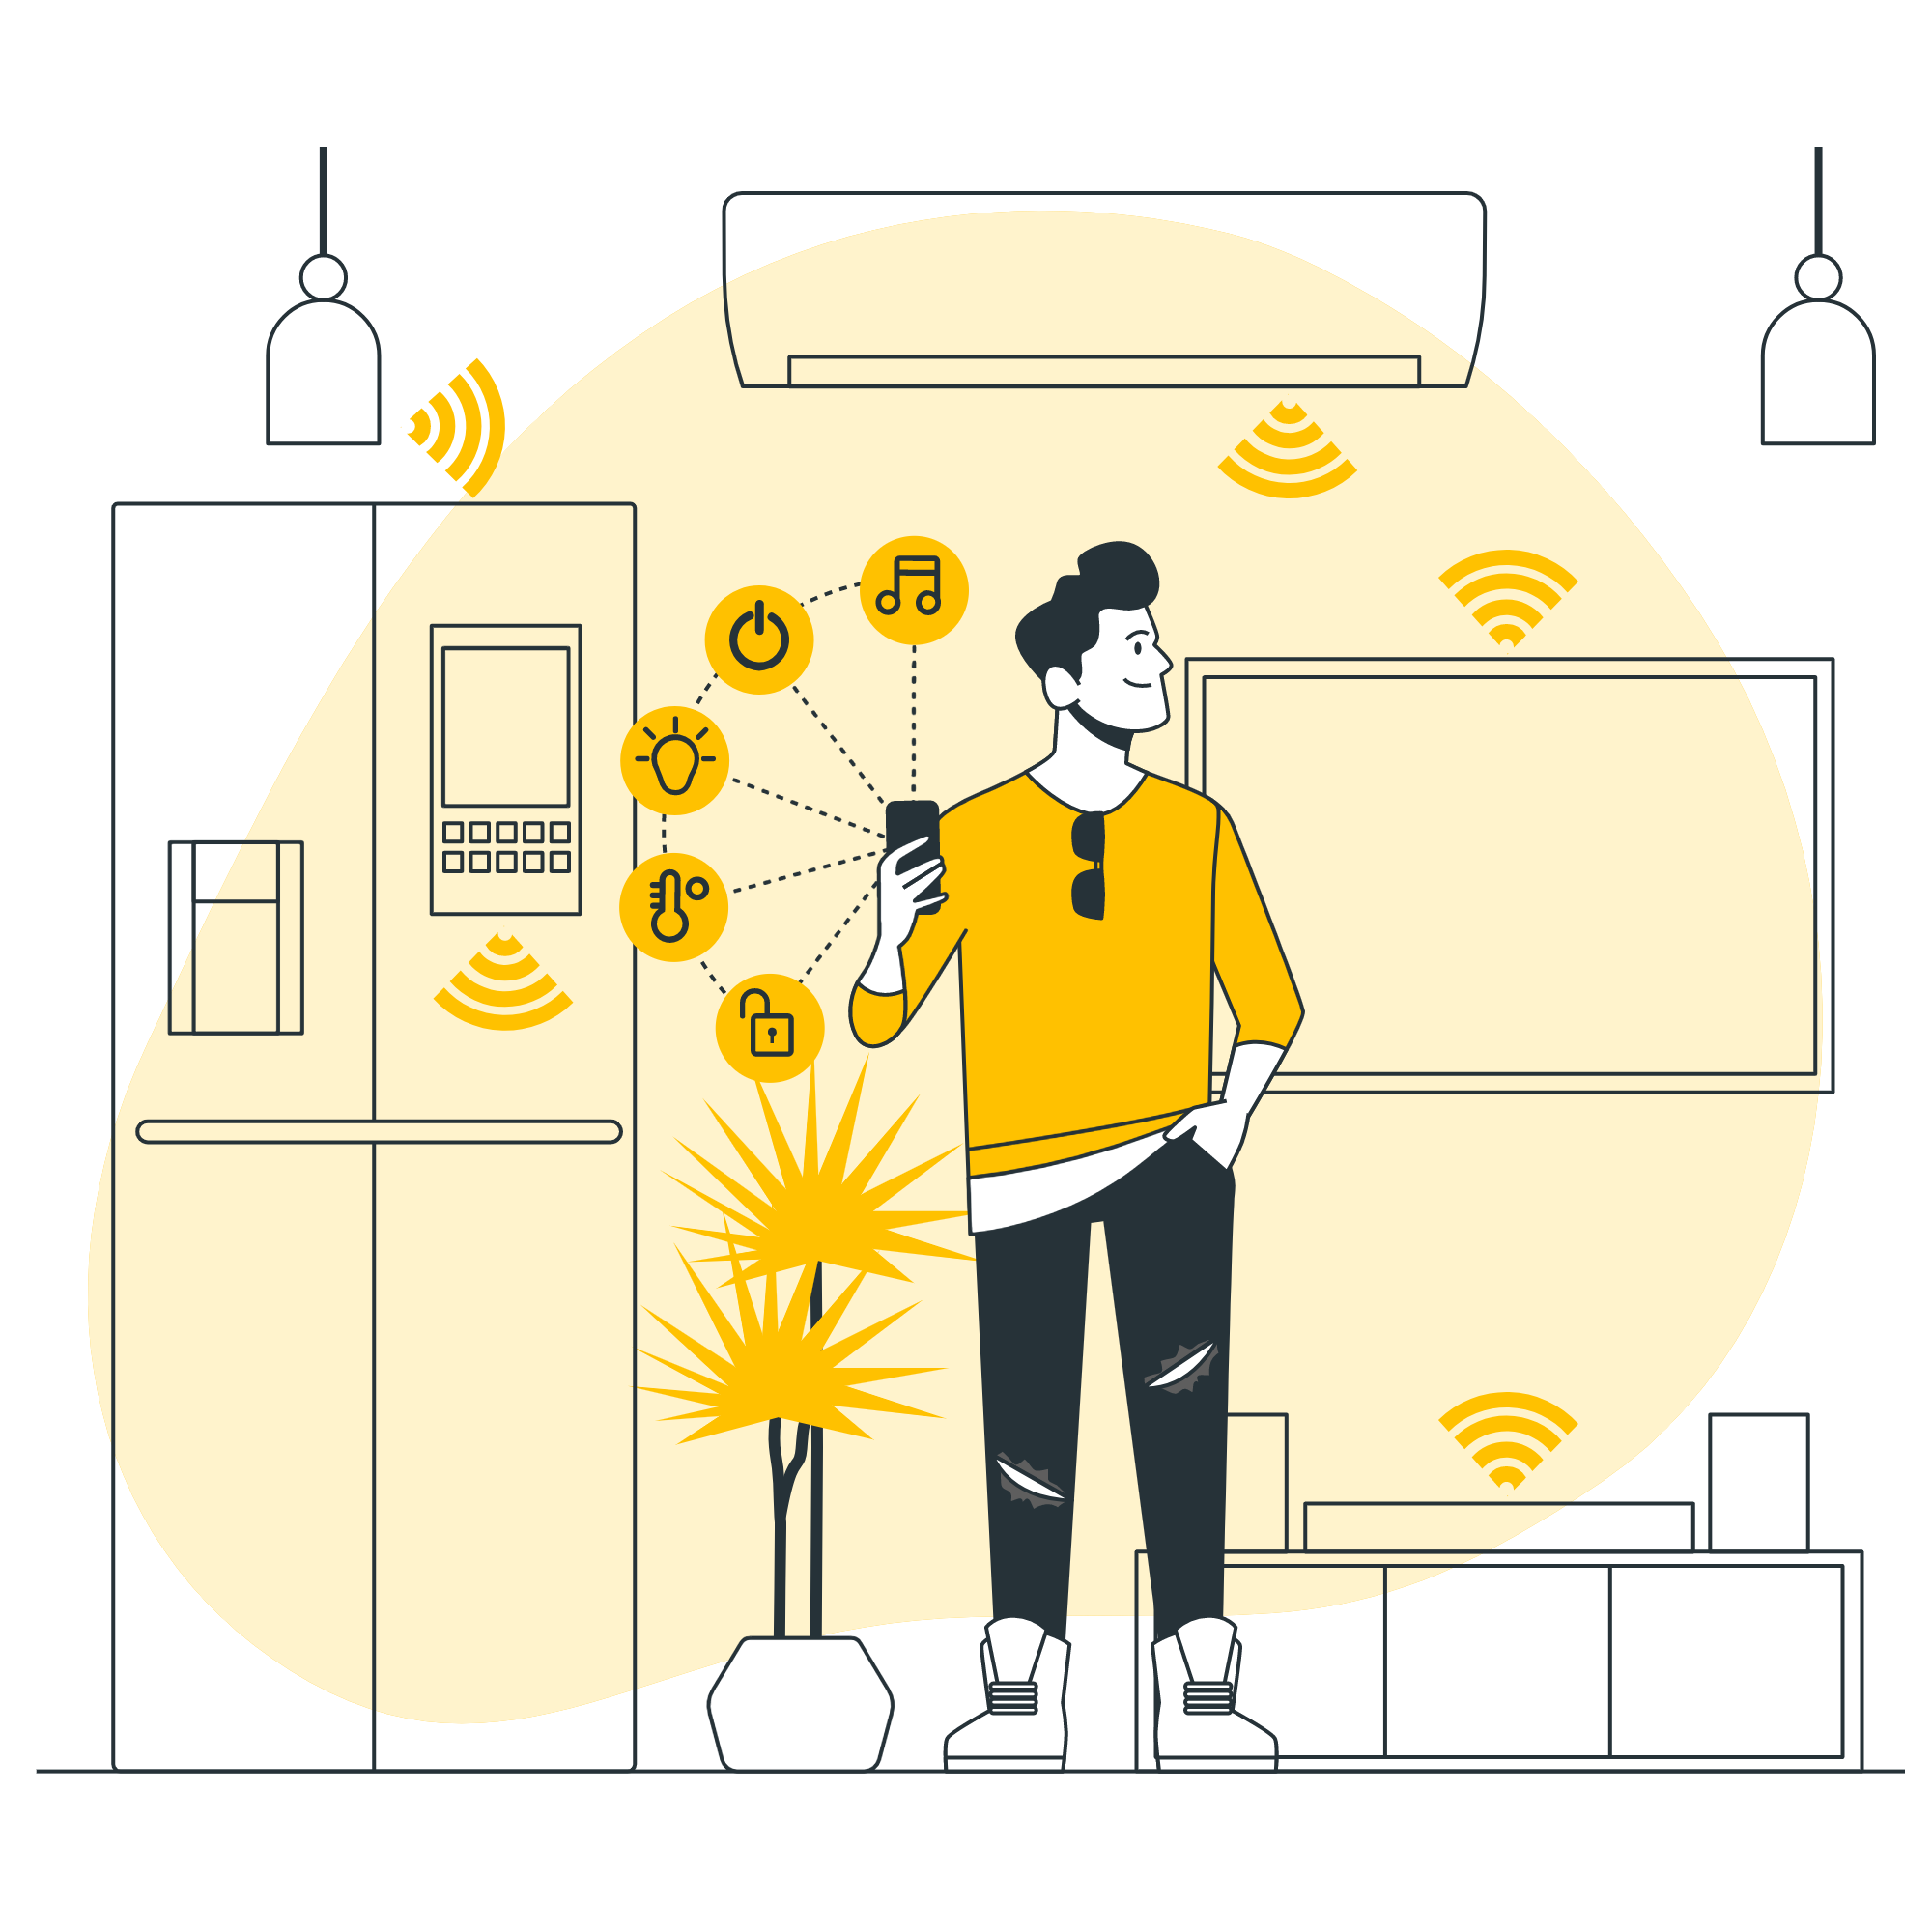
Explanation of the individual nodes
02
An overview of all the nodes in the environment

Slide 6
Base node
The Base node is a parent class that all nodes inherit from. This includes a list of default functions such as returning the node’s name and its MQTT id.

Slide 7

Entrance monitor
Node monitoring all windows and doors

Slide 8
Front door
Node monitoring the front door

Slide 9
Heating
Node monitoring all the heaters

Slide 10
Lights
Node monitoring all the lights

Slide 11
Safety
Node monitoring the CO2 and Smoke Detectors

Slide 12
Speaker control
Node monitoring all the speakers

Slide 13
The main and the GUI
Main and GUI:
Tests:
The node monitoring all nodes and communications, its gui and the tests make for it

Slide 14

The MQTT System
03
How we implemented MQTT

Slide 15
Explanation
All our nodes and our discord communicate through MQTT

Slide 16

The Discord
04
An overview of our server

Slide 17
Overview
Explanation of overall receiving messages and sending them code

Slide 18
Help command
A command showing all the possible commands

Slide 19
Inspire command
A command that sends a motivational quote

Slide 20
Encouragements
The bot sends encouraging messages when the user sends a sad message

Slide 21
Registration process
Setting up the devices and collecting the user info

Slide 22
Receiving commands
How the discord receives strings via MQTT from external nodes

Slide 23

Unit tests
05
An overview of the unit tests implemented

Slide 24
Overview
An overview of the tests and how to run them

Slide 25

Recap
06
A quick recap

Slide 26
Final demonstration
Demonstration of the main features of our product

Slide 27
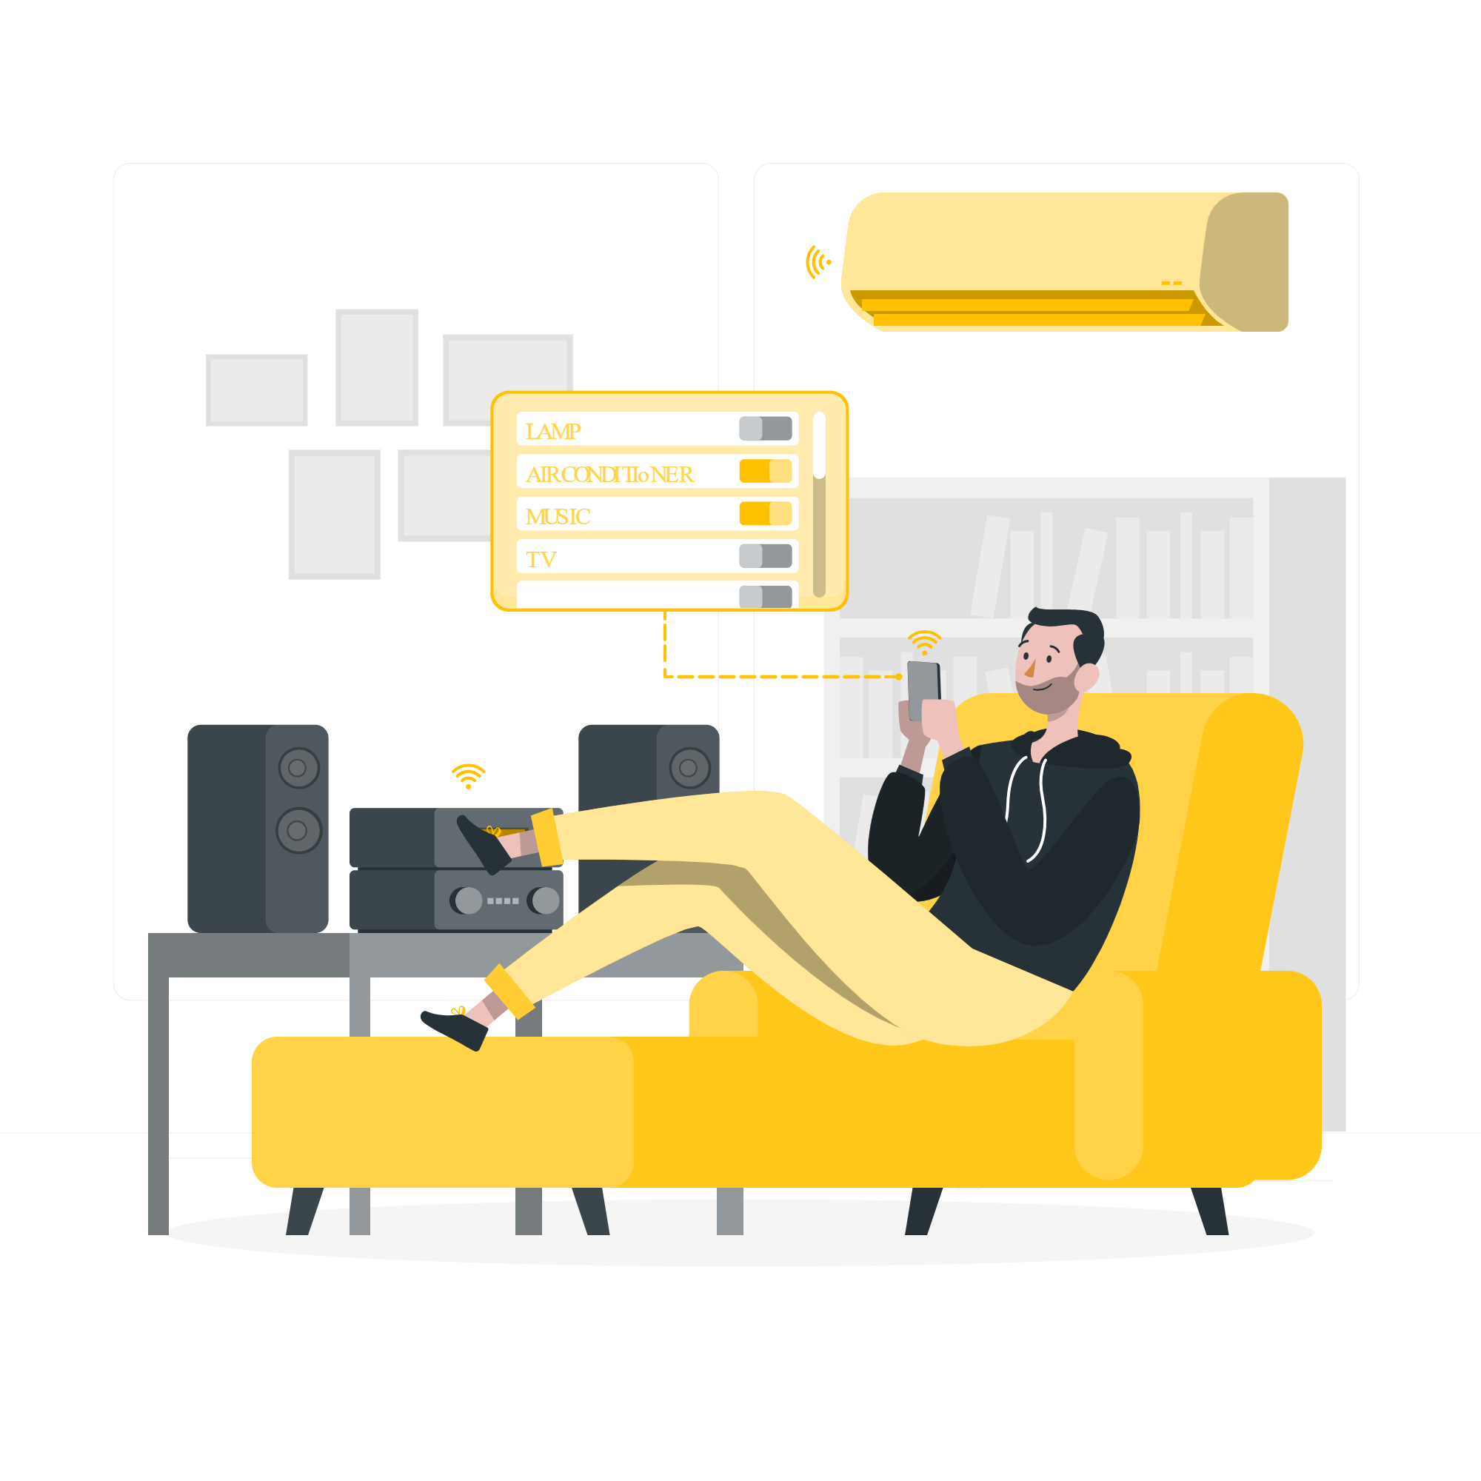
To summarise

Slide 28
Thanks you for watching!

